Slide 1
Modeling and simulation of a liquid level system
Emanuel Cruvinel

Slide 2
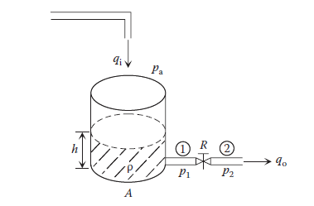
Overview
Figure taken from Esfandiari, Ramin S._ Lu, Bei - Modeling and Analysis of Dynamic Systems, Third Edition-CRC Press (2018)

Slide 3
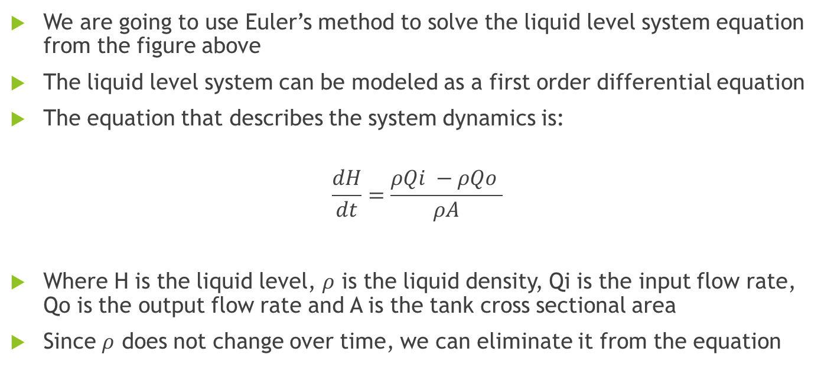
Overview
We are going to use Euler’s method to solve the liquid level system equation from the figure above
The liquid level system can be modeled as a first order differential equation
The equation that describes the system dynamics is:
$$\frac{dH}{dt}=\frac{ρQi −ρQo }{ρA}$$
Where H is the liquid level, $ρ$ is the liquid density, Qi is the input flow rate, Qo is the output flow rate and A is the tank cross sectional area
Since $ρ$ does not change over time, we can eliminate it from the equation

Slide 4
Input parameters
Tank cross sectional area (A): 10 m^2
Initial liquid level (H(1)): 30 m
Euler time step: (b-a)/N, where b = 5 s, a = 0 s and N = 100 points
Input flow rate (Qi): 20*t (time dependent) m^3/s
Output flow rate (Qo): 10*t (time dependent) m^3/s

Slide 5
Matlab Code
clc, clear all, close all
A = 10; %area do tanque em m^2
H(1) = 30; %altura inicial da coluna de liquido no tanque
a = 0; %ponto inicial usado no metodo de euler
b = 5; %ponto final usado no metodo de euler
N = 100; %numero de pontos usado no metodo de euler
passo = (b-a) / N; %passo usado no método de euler
t = passo.*(0:1:N) %tempo de 0 a 5 segundos
Qi = 20.*t; %vazão de entrada m^3/s
Qo = 10.*t ;%vazão de saída m^3/s
for i = 1:N
H(i+1) = H(i) + passo.*(Qi(i) - Qo(i))./ A ;%altura em função dos parametros de entrada
end
plot(t,H)
xlabel('Time (s)','FontSize',12,'FontWeight','bold','Color','black')
ylabel(‘Liquid level(m)','FontSize',12,'FontWeight','bold','Color','black')
grid()

Slide 6
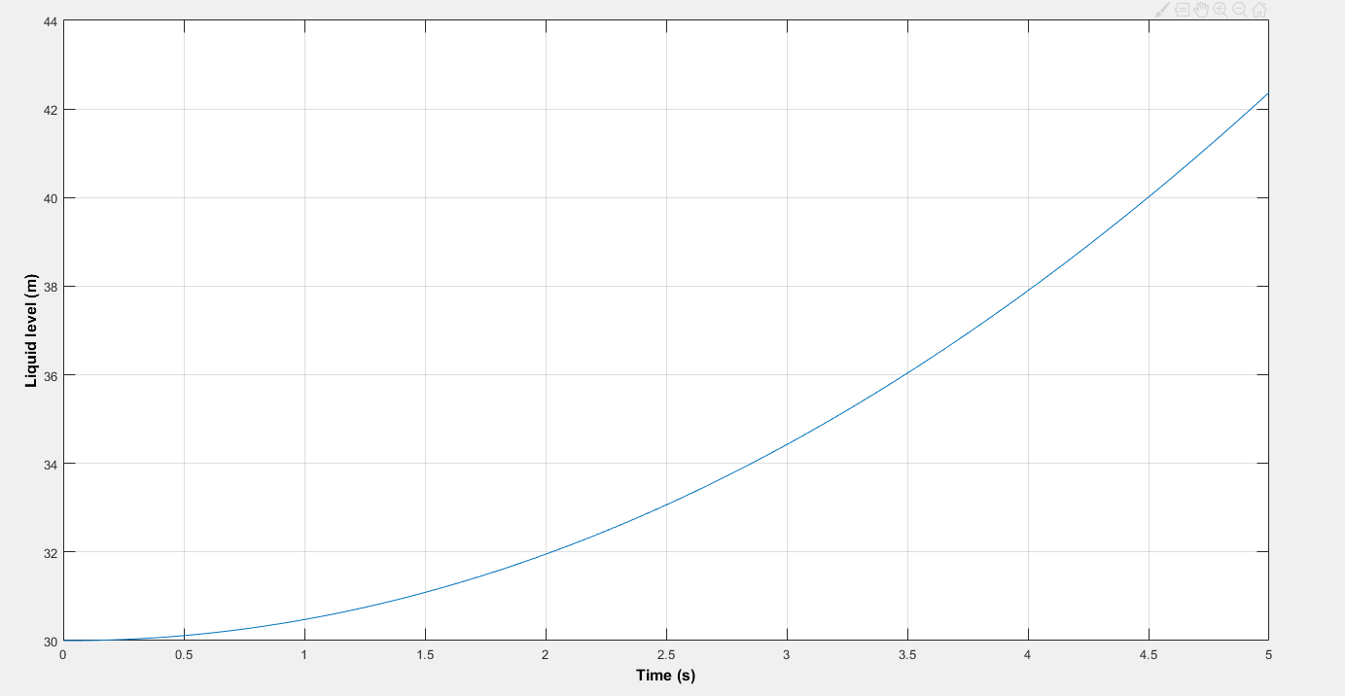
Results

Slide 7
Results
From the plot above, the liquid level at five seconds reaches 42.375 meters

